Slide 1
Europeans Establish Colonies
Chapter 2

Slide 2
Spanish Empire in America
Section 1

Slide 3
List as many countries as you can from Central America, the Caribbean Islands and South America
(Essentially any Spanish speaking country)

Slide 4
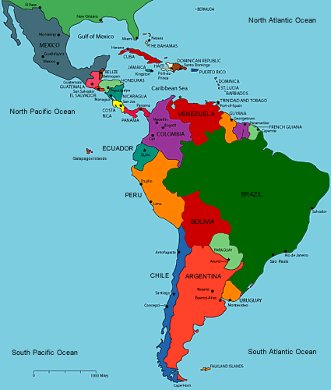

Slide 5
Spanish Empire (1530’s)
New Spain
Peru
Ruled by a VICEROY appointed by a king
Mexico
Central America
Caribbean Islands
Also ruled by a VICEROY
South America ( but not Brazil )

Slide 6
Spain Colonizes Florida
Florida was to be a DEFENSIVE ZONE against the English in the North
St. Augustine is the 1st established town in present day USA
Only 1k Spanish move to Florida

Slide 7
Spanish Society
250k Spanish move to the America’s
Mestizo is a mix of Spanish and Native people
Use “encomienda” system: Used natives as slaves
Exists well before the African slave trade begins

Slide 8
Spanish Explorers ( Hernando De Soto)
1542 encounters present day FLORIDA
1st European to cross Mississippi River
Dies of disease and men retreat back to Mexico

Slide 9
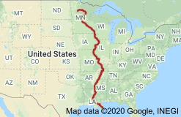

Slide 10
Francisco Coronado
Natives trick him by telling him tales of a Golden Kingdom (Cibola)
Meant to occupy his time
Leaves Mexico in search and encounters the state of Kansas
Eventually retreats back to Mexico

Slide 11
Native Resistance: Pueblo Revolt
Drought and disease occurs in late 1600’s virtually starving the enslaved PUEBLO’s
Pop. Cut from 40k to 17k
Result: Most successful Native American revolt
Spanish leave Santa Fe for El Paso

Slide 12
Section 1 Review:
1. What were the 2 new territories of the Spanish Empire? What current areas did each include?
2. What was the 1st established town in the U.S?
3. What were the end results of De Soto’s journey?
4. What was the result of the PUEBLO REVOLT?

Slide 13
The French Empire
Section 2

Slide 14
New France
French are NOT looking to establish colonies
Rather make MONEY and bring it back to France
They trade the Natives metal tools and weapons for beaver pelts
Pelts were very valuable in Europe

Slide 15
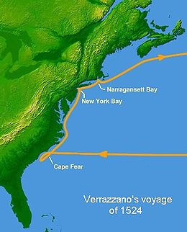
French in North America
Giovanni Da Verrazano
Italian who sailed for France
Created map of East U.S and Canada
Bridge in NY named after him

Slide 16
Jacques Cartier
Claims what is now CANADA for France
Sets up 1st settlement
Eventually named after the Iroquois word “Kanata” or village

Slide 17
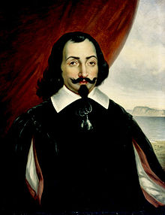
Samuel De Champlain
“Father of New France”
Founded 1st French Colony in Quebec
Used natives to help explore Canada

Slide 18
Louisiana and New Orleans
Robert De La Salle (1682) hoping to find NORTHWEST PASSAGE (water route to Asia)
Instead find Louisiana in honor of French King Louis 14th
New Orleans becomes its biggest town as its located near water

Slide 19
Section 2 Review:
1. What was France looking to do in the NEW WORLD?
2. What was an accomplishment of Cartier?
3. What was an accomplishment of De Champlain?
4. Who was LOUISIANA named after?

Slide 20
England’s Southern Colonies
Section 3

Slide 21
Roanoke (Lost Colony)
One of U.S GREATEST mysteries
1590 – 2 ships arrive from England to resupply Roanoke and find all original setters missing
Word “CROATOAN” is found engraved on a tree
Settlers never found (remains unsolved)

Slide 22
Jamestown 1607 (1st Est. Colony)
100 original settlers
Reasons for original failure (5):
1. Conflict with Natives
2. Unrealistic Expectations
(wealthy did not want to work)

Slide 23
Cont.
3. Location
Near Swamp = mosquito’s / disease
4. Starvation
Without Native help colony would have died in one year / could not grow food
5. Poor Leadership
Internal fighting / power struggle once failure begins

Slide 24
Tobacco
Tobacco was staple or CASH crop
Only Spanish were allowed to have tobacco seed
Caught selling it to others was punishable by DEATH
Without tobacco Jamestown would’ve failed
Used indentured servants
7 years of work and you would get a piece of land at the end

Slide 25
Georgia
Found by James Oglethorpe (1732)
Colony for PRISONERS and debtors to work land instead of jail sentence (in England)
Soon African slaves would be brought to work the entire south instead of prisoners

Slide 26
Maryland
Named after Queen Mary of England
Governed by Lord Baltimore (Baltimore City)
Refuge colony (safe place) for Catholics who were discriminated against in Europe
More Protestants end up moving in; this causes later battles

Slide 27
Section 3 Review:
1. What was the “Lost Colony”?
2. List and describe 3 of the reasons Jamestown failed.
3. What type of people lived in Georgia?
4. Who was Maryland and Baltimore named after? Why was it started?

Slide 28
The New England Colonies
Section 4

Slide 29
Puritanism
Started by John Calvin
Got to heaven by leading moral life, praying and reading Bible daily
God decided if you went to Heaven, not your behavior (predestined)
People thought they had better chance if they were good

Slide 30
1st Settlers 1620; Plymouth Bay Colony
Arrive on boat called THE MAYFLOWER
People were called PILGRIMS
100 in total
Agreed to follow a set of rules (MAYFLOWER COMPACT)
Celebrate 1st Thanksgiving 1621; (53 colonists / 90 natives)

Slide 31
Plymouth Bay Colony
English settlement in New England
Arrive in the late fall (very cold)
½ population die in 1st winter
Starvation
Eat shoe leather and ponder (think about) CANIBALISM for survival

Slide 32
Massachusetts Bay Colony
20,000 people in 20 towns (Great Migration)
Made up of Puritans who were NOT tolerant of other religions
Must attend church (several times daily / must pay church taxes
Punishment was often banishment

Slide 33
Salem Witch Trials
Accused each other of practicing WITCHCRAFT
20 people executed by being; burned at the stake, stoned or crushed
Gave impossible tests to pass to show innocence

Slide 34
Dissent in the Puritan Community
Roger Williams; Banished from MBC
Starts the RHODE ISLAND COLONY
Tolerant to all religions except Catholic
Believed land should be purchased from Natives, not taken
Thought all male heads of family should be able to vote

Slide 35
Anne Hutchinson
Arrived in MBC in 1634
Challenged the churches ideas about women being less than men
Banished from the colony to New Netherland
Killed in a Native American attack

Slide 36
Section 4 Review:
1. Where did the 1st New England Settlers land? What was their boat called?
2. Describe the MASS BAY COLONY.
3. Which colony did ½ the population die in the 1st winter? Why did they die?
4. What did Williams and Hutchinson have in common?

Slide 37
Middle Colonies
Section 5

Slide 38
The Dutch in New York
New Amsterdam is present day MANHATTAN
Build a wall (Wall St.) to defend the island
England takes over when Charles II declares the land is his brothers, the Duke of York
Gov. Stuyvesant is forced to surrender it

Slide 39
New Jersey 1664
Fertile land for farming / religious tolerance
Also part of the Duke of York’s territory
Small colony; very poor
Located between DELAWARE and HUDSON rivers

Slide 40
Pennsylvania (Penn’s Woods)
Founded by WILLIAM PENN
Settlers were mostly Quakers
Pacifists (peaceful) / refused to use weapons
PA was a haven (safe place) for all faiths

Slide 41
PA Continued…
Penn acquired PA bc he was owed $ by King Charles II of England
By 1700 over 20k people
Names his capital city PHILADELPHIA “City of Brotherly Love”
Penn treated all people with equal respect (women / natives / and other religions)

Slide 42
Delaware
Originally part of Sweden
Name after Baron De La Warr
Only 500 people / mostly farming
Eventually conquered by PETER STUYVESANT (Dutch)

Slide 43
Section 5 Review:
1. What was Manhattan originally called? Why was Wall St. built?
2. Where is NJ located?
3. Who founded Pennsylvania? Which religion?
4. Which country originally settled Delaware? Who conquered it?

